Slide 1

Smart College
Team number-22
M. Rohith-089
B. Sai Kumar-094
M.Akash-063

Slide 2
Abstract:
Concept of smart college can one be of the emerging trend in ML in coming up years where the thought of ‘Smart Campus, Secure Campus’ may become the new mantra. Our project focus on helping the management for taking quick attendance and it also help teachers to predict which student can be able to get a placement or not. This project is also helpful in knowing about the college for newly joined students through an interactive chat bot .Furthermore, the project will present and discuss an idea about smart college using the concepts of Machine Learning.

Slide 3
Overall Architecture:
Smart intelligent featured apps used in college
Face attendance system
Placements Prediction
Interactive Chatbot
Frontend technologies and core functionalities
Html and css based pages
All functionalities
Handled through python
Different Machine learning models
Backend technologies
Sql database
Excel sheets

Slide 4
Software Requirements:
Python Libraries which include : Numpy ,sklearn ,pandas ,opencv,flask and nklt
Tool used: Pycharm Editor
For database tool used: Microsoft Sql Server Management studio
For Frontend Technologies Used : Html,Css, JavaScript
Computer Specifications Required: 4 Gb ram, Windows Os, 2 Gb Rom.

Slide 5
References:
https://scikit-learn.org/stable/modules/svm.html
https://www.tutorialspoint.com/tutorial_view.htm?cid=flask&pid=
https://www.w3schools.com/html/
https://www.w3schools.com/js/
https://towardsdatascience.com/cnn-based-face-detector-from-dlib-c3696195e01c

Slide 6
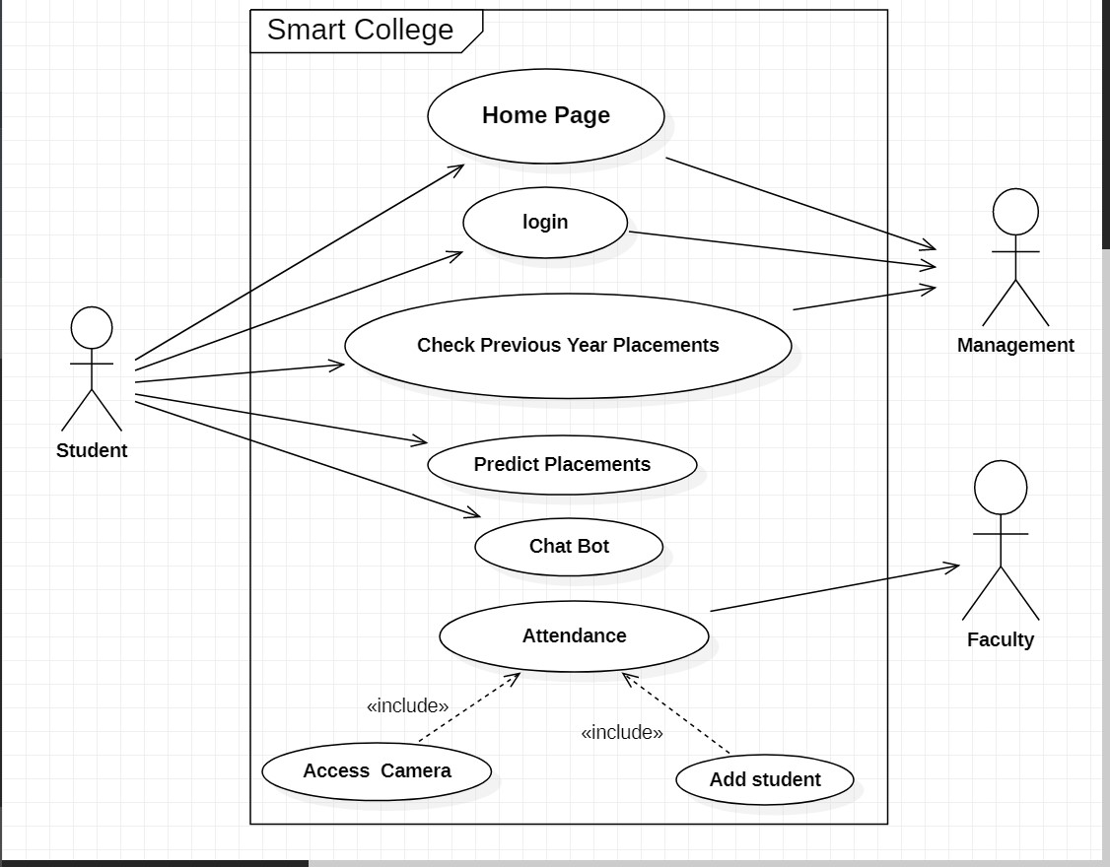
Use Case Diagram:

Slide 7
Modules In the Use Case Diagram are: Home Page, Login, Check Previous Year Placements, Predict Placements, Chat Bot and Attendance.
There are mainly 3 actors in the Use Case Diagram : 1.) Student 2.) Faculty 3.) Management
Student: Mainly a student can predict placements, make queries in the chat bot and look over the previous year placements.
Faculty: The Main function of the faculty is to take attendance in fair and secure manner through camera.
Management: Management mainly controls the login credentials and overall functioning of the Smart College System.

Slide 8
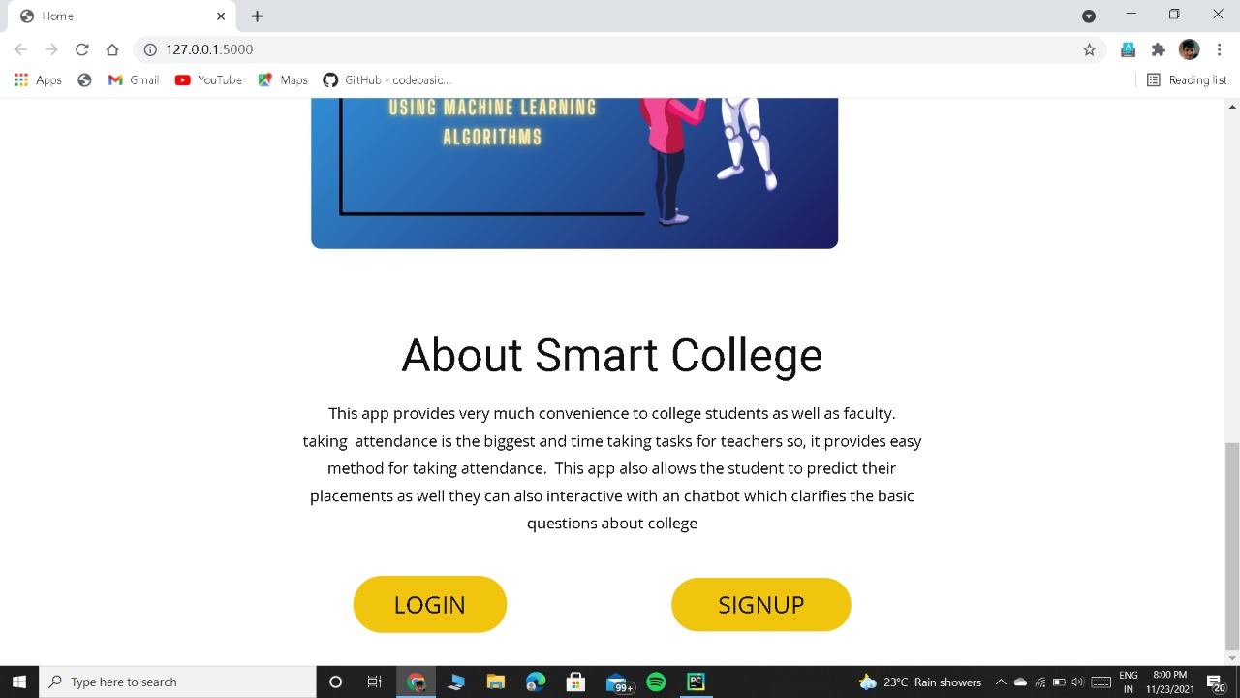

Slide 9
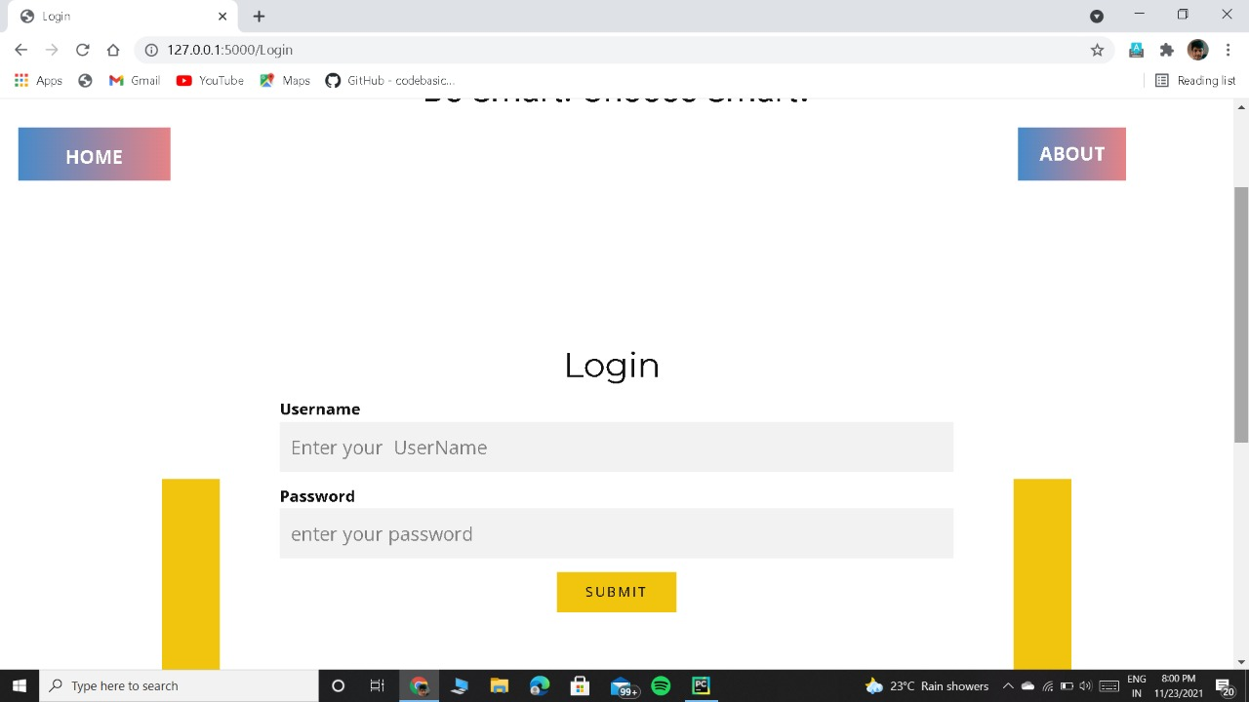

Slide 10
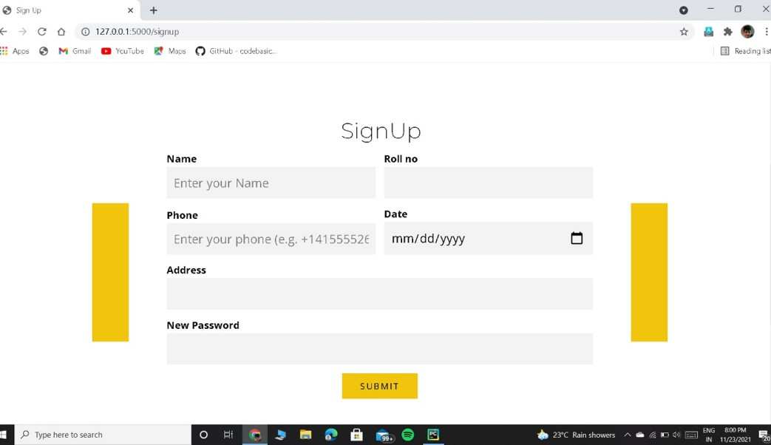

Slide 11
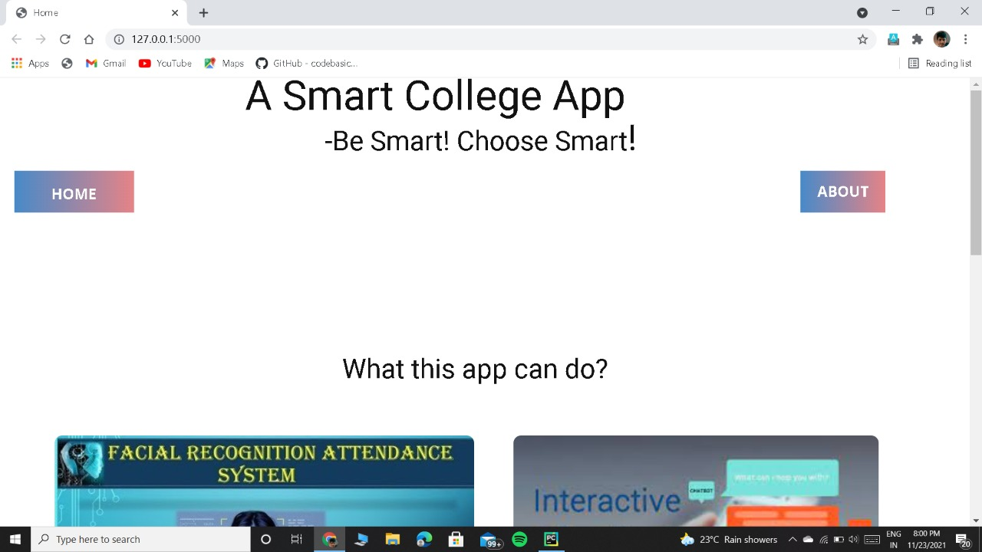

Slide 12
